Slide 1


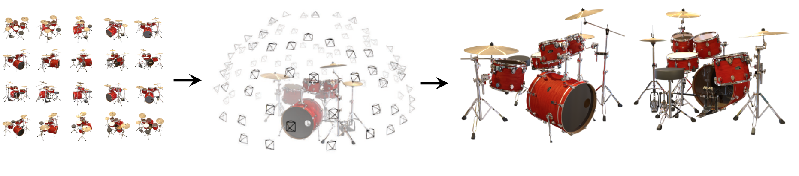
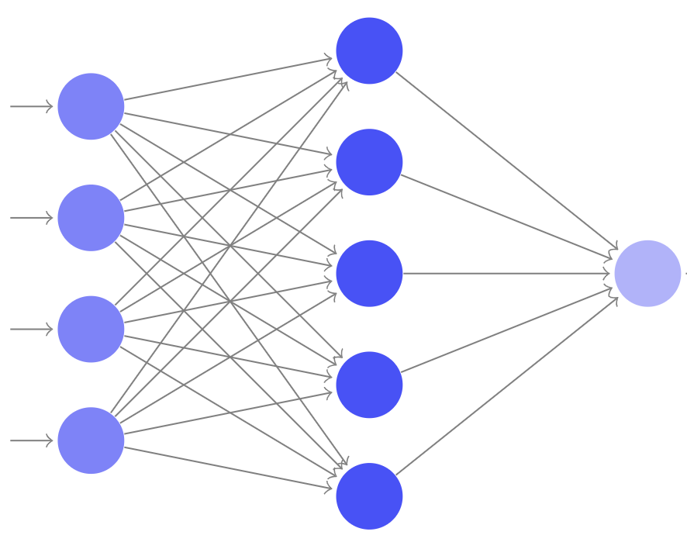
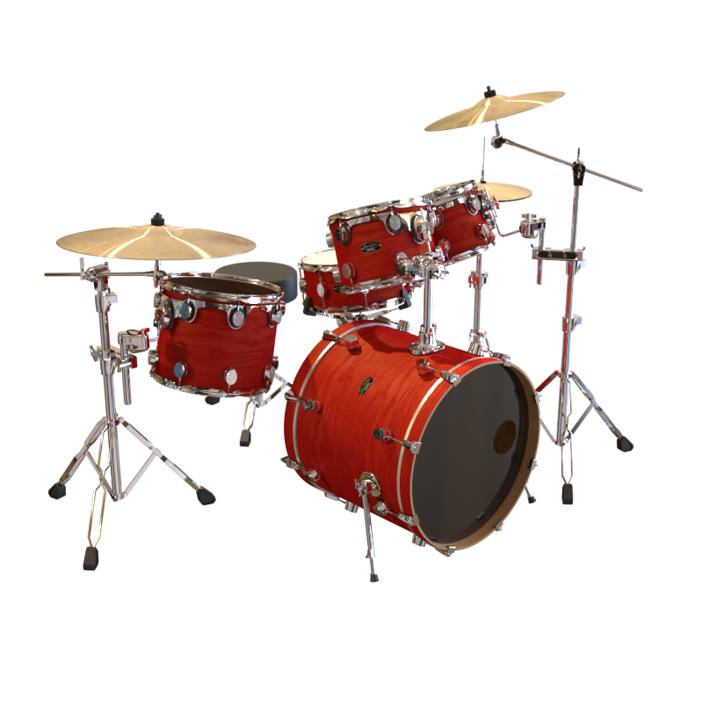
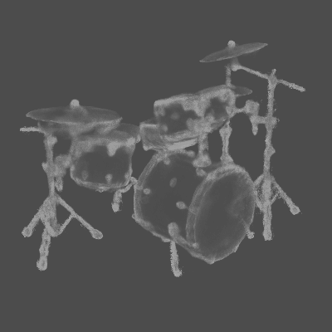
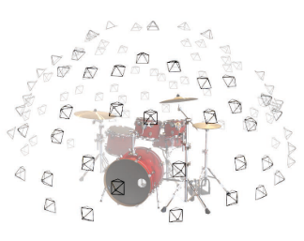
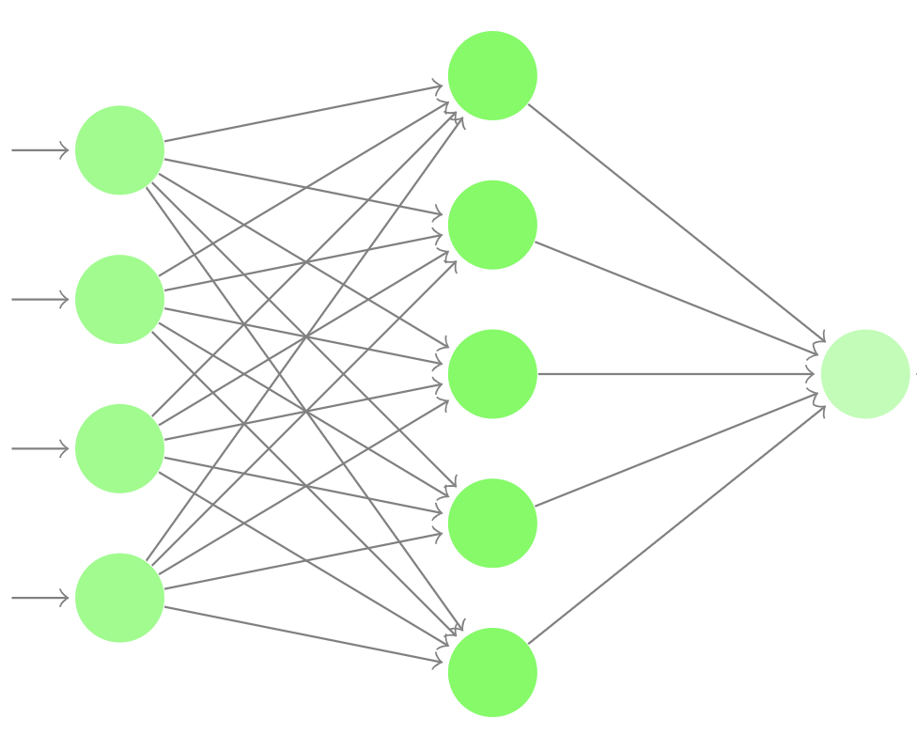
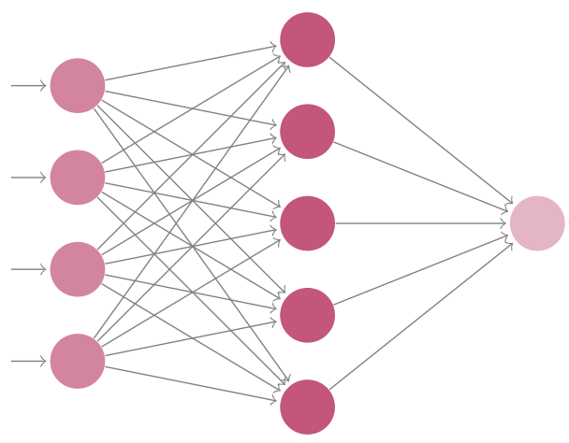
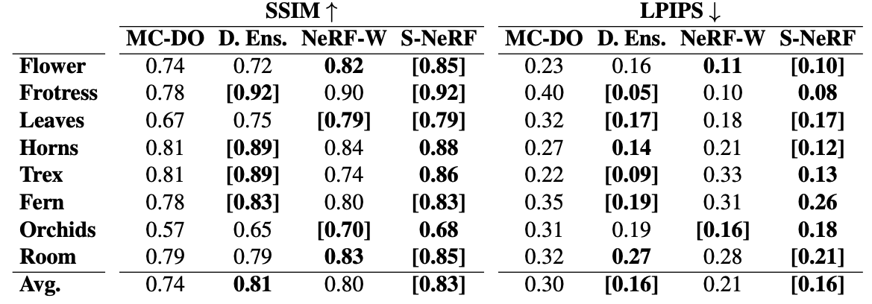
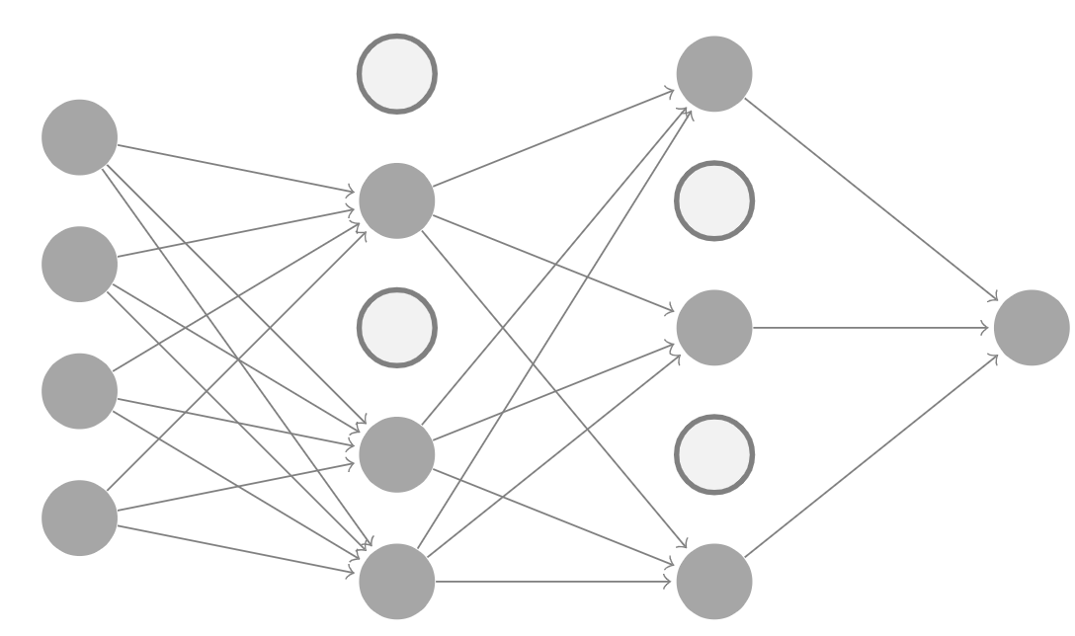
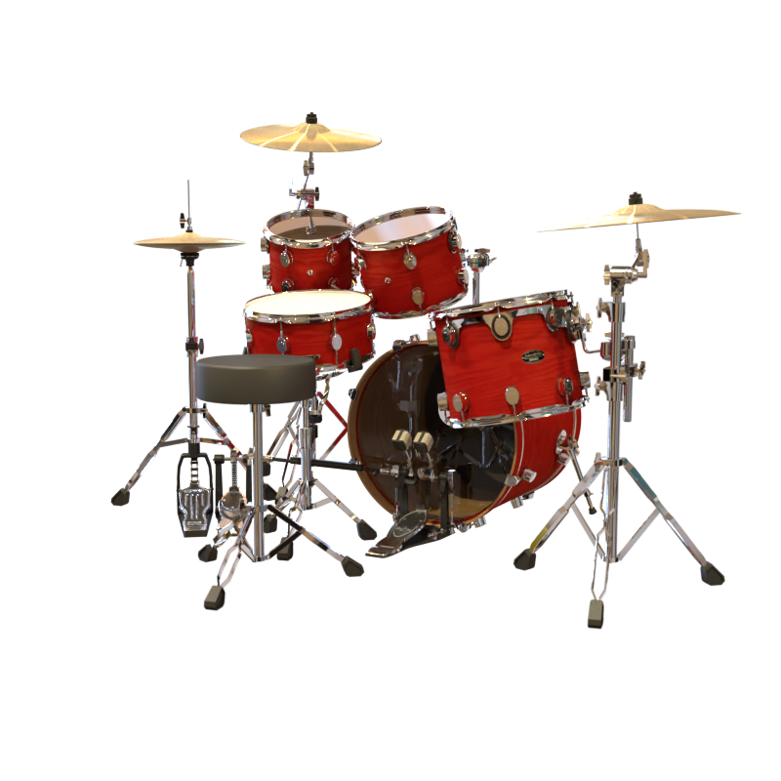
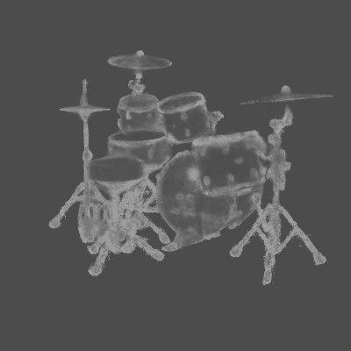
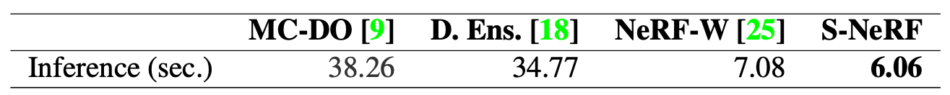
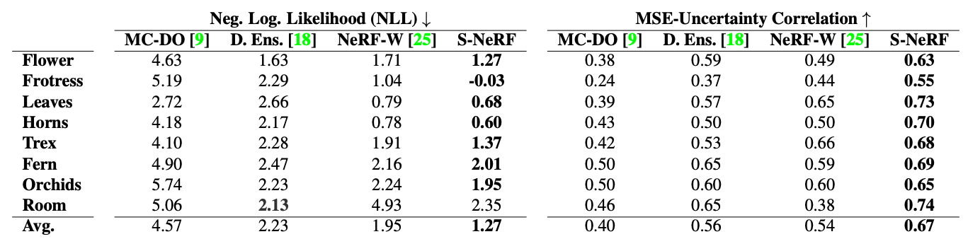
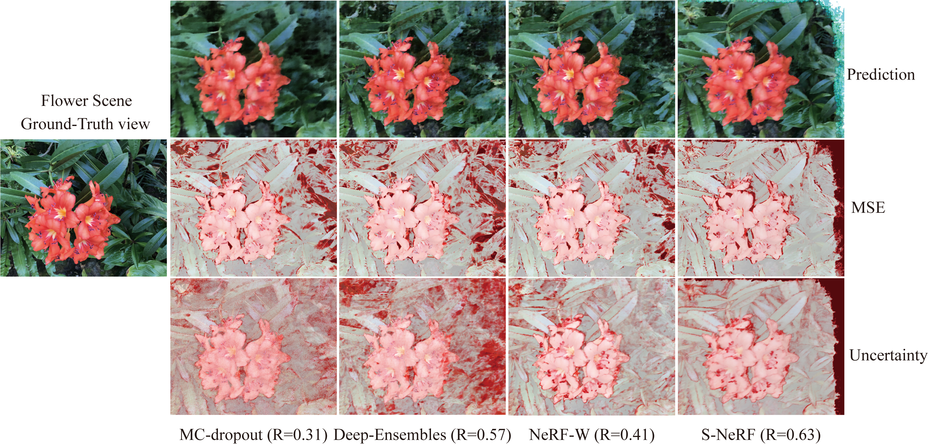
Stochastic Neural Radiance Fields: Quantifying Uncertainty in Implicit 3D Representations Jianxiong Shen Adrià Ruiz Antonio Agudo Francesc Moreno-Noguer Institut de Robòtica i Informàtica Industrial (CSIC-UPC)
1. Limitation of Neural Radiance Fields (NeRF)
2. Ensemble-like Uncertainty Estimation
4. Quantitative and qualitative results
Input images
(1) Deep-Ensembles
prediction
LLFF benchmark dataset (indoor & outdoor scenes)
Evaluation Metrics on Uncertainty estimation
Optimize NeRF
Render novel views
N models
Predict.
Uncertainty
N passes
Negative log-likelihood (NLL)
MSE-Uncertainty correlation
Image quality (SSIM, LPIPS)
Rendering time
Models
Forward
pass
Time
complexity
(2) MC-Dropout
N passes
Deep
Ensembles
N
N
N*N
Model prediction correctness not known
No confidence information associated with the model outputs
Could make Risky decisions based on the model estimations
MC-dropout
1
N
N
S-NeRF(ours)
1
1
1
Computationally expensive, both need multiple inference passes compared with NeRF
3. Stochastic Neural Radiance Fields (S-NeRF)
Deterministic NeRF
Stochastic NeRF
For any 5D input, they get single estimate for density and color
For any 5D input, we estimate distribution for density and color
Spatial
location
direction
color
density
color
distribution
density
distribution
Learning process by S-NeRF
Compared with current general methods:
Better uncertainty estimation performance (red)
Estimated uncertainty correlate better to predicted error (red)
Comparable image quality (blue)
Less rendering time (green)
For each coordinate along a camera ray with direction, a neural network predicts the parameters of the color and density distributions
For each spatial-location, we sample and generate a set of radiance-density trajectories from the previous distributions
The volume rendering equations are then used to estimate the RGB values for each trajectory and compute the log-likelihood for a given pixel color
Correctly estimate uncertainty for unobserved region
Estimate uncertainty for 3D geometry such as Depth-Uncertainty
High uncertainty
low uncertainty

